Slide 1
Classroom Notebook
Charity Fischer
Fall 2018
EECT 112

Slide 2
Classroom Notebook index
Lecture
Lecture 1b
Lecture 3a
Free-Form Lecture
Lecture 4
Page Number
3
6
11
13

Slide 3
Lecture 1b
6 | 1000000 | 10^6 | M | mega
5 | 100000 | 10^5
4 | 10000 | 10^4
3 | 1000 | 10^3 | k | kilo
2 | 100 | 10^2
1 | 10 | 10^1
0 | 1 | 10^0
-1 | 0.1 | 10^-1
-2 | 0.01 | 10^-2
-3 | 0.001 | 10^-3 | m | milli
-4 | 0.0001 | 10^-4
-5 | 0.00001 | 10^-5
-6 | 0.000001 | 10^-6 | u | micro
-7 | 0.0000001 | 10^-7
-8 | 0.00000001 | 10^-8
-9 | 0.000000001 | 10^-9 | n | nano
Lecture 1b slide 2
In slide two of lecture 1b we learned about exponential powers and how to used them in scientific notation
On the right are the prefix names of the values depending on the exponential value of the number

Slide 4
Lecture 1b
2^4 | 2^3 | 2^2 | 2^1 | 2^0
16 | 8 | 4 | 2 | 1
0 | 0 | 0 | 0 | 0 | 0
0 | 0 | 0 | 0 | 1 | 1
0 | 0 | 0 | 1 | 0 | 2
0 | 0 | 0 | 1 | 1 | 3
0 | 0 | 1 | 0 | 0 | 4
0 | 0 | 1 | 0 | 1 | 5
0 | 0 | 1 | 1 | 0 | 6
0 | 0 | 1 | 1 | 1 | 7
0 | 1 | 0 | 0 | 0 | 8
0 | 1 | 0 | 0 | 1 | 9
0 | 1 | 0 | 1 | 0 | 10
0 | 1 | 0 | 1 | 1 | 11
0 | 1 | 1 | 0 | 0 | 12
0 | 1 | 1 | 0 | 1 | 13
0 | 1 | 1 | 1 | 0 | 14
0 | 1 | 1 | 1 | 1 | 15
1 | 0 | 0 | 0 | 0 | 16
Lecture 1b Slide 5
Based on exponentials we learned the basics of binary, a base two system, how to calculate it and how to count with it. In the rightmost column I have our typical base 10 numbers
The first conversion I did was from 5 bit binary and 8 bit binary to decimal
This is done by multiplying each 1 and 0 by 2 whose exponent changes depending on the position which are listed on the top row

Slide 5
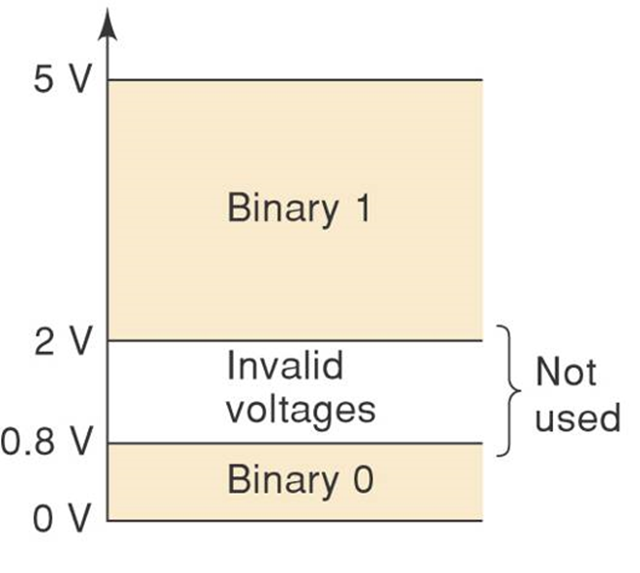
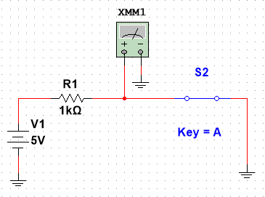
Lecture 1b
Lecture 1b Slide 8
Here we learned the basics of reading voltages where 0V-0.8V is a logic zero and 2V-5V is a logic one. 0.8V-2V is treated as invalid
In building this circuit it helped to illustrate how to read a voltage with the Multimeter
When the switch is closed as pictured here the current runs past the Multimeter and, though it does read as a very small number (500 nV), it reads as a logic 0
When the switch is open the voltage runs through the Multimeter and reads 5 volts which is called a logic 1

Slide 6
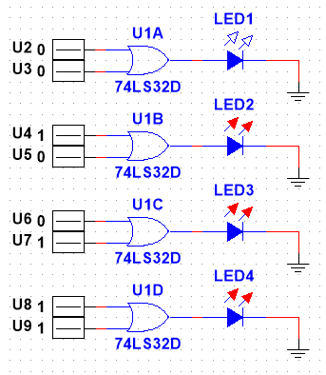
Lecture 3a
Lecture 3a Slide 7
Two input OR logic gates (or 74ls32) were introduced in this slide
The truth table for a 2 input OR gate essentially says that the output will be a logic 1 if any of the inputs are a logic 1
2-input
A | B | Out
0 | 0 | 0
0 | 1 | 1
1 | 0 | 1
1 | 1 | 1
Happiness where A, B, and C are different flavored milkshakes

Slide 7
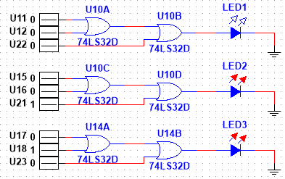
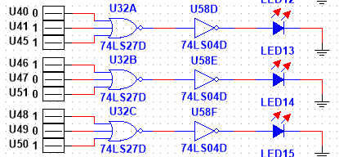
Lecture 3a
3-input
A | B | C | Out
0 | 0 | 0 | 0
0 | 0 | 1 | 1
0 | 1 | 0 | 1
0 | 1 | 1 | 1
1 | 0 | 0 | 1
1 | 0 | 1 | 1
1 | 1 | 0 | 1
1 | 1 | 1 | 1
Lecture 3a Slide 8
In this slide we attempted to make a 3 input OR gate. First by using 2 2 input OR gates then by finding a specific 3 input OR gate
The rule for a 3 input OR gate truth table is the same as for a 2 input OR gate in that any logic 1 input will make the output a logic 1

Slide 8
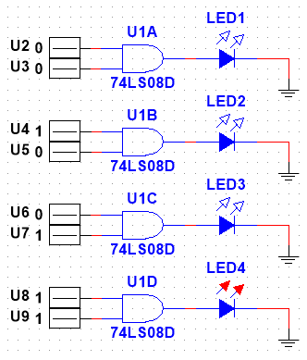
Lecture 3a
Lecture 3a Slide 10
Two input AND logic gates (or 74ls08) were introduced in this slide
The truth table for a 2 input AND gate essentially says that the output will be a logic 1 if and only if all of the inputs are a logic 1
2-input
A | B | Out
0 | 0 | 0
0 | 1 | 0
1 | 0 | 0
1 | 1 | 1
Happiness where A, B, and C are parts of a complete meal

Slide 9
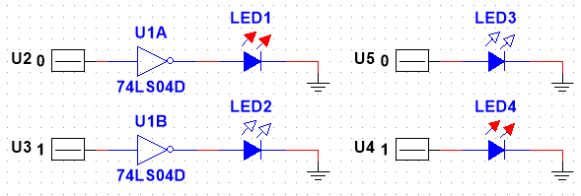
Lecture 3a
Lecture3a Slide 13
Hex inverters (74ls04) were introduced in this slide
They very simply output the opposite of what the input is

Slide 10
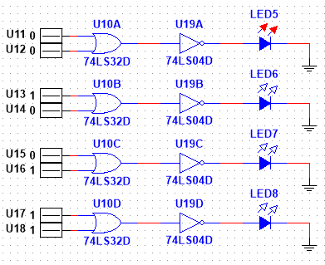
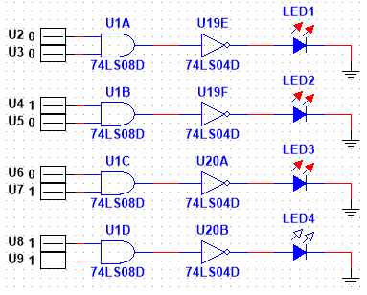
Lecture 3a
OR inverted truth table
A | B | Out
0 | 0 | 1
0 | 1 | 0
1 | 0 | 0
1 | 1 | 0
Lecture 3a Slide 16
In this slide was an attempt to put more than one logic gate in a single circuit
As expected it made our truth tables the opposite of what they were without the 74ls04
AND inverted truth table
A | B | Out
0 | 0 | 1
0 | 1 | 1
1 | 0 | 1
1 | 1 | 0

Slide 11
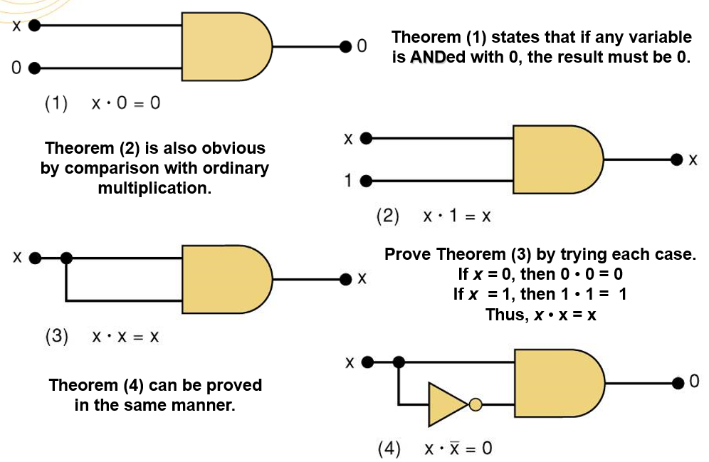
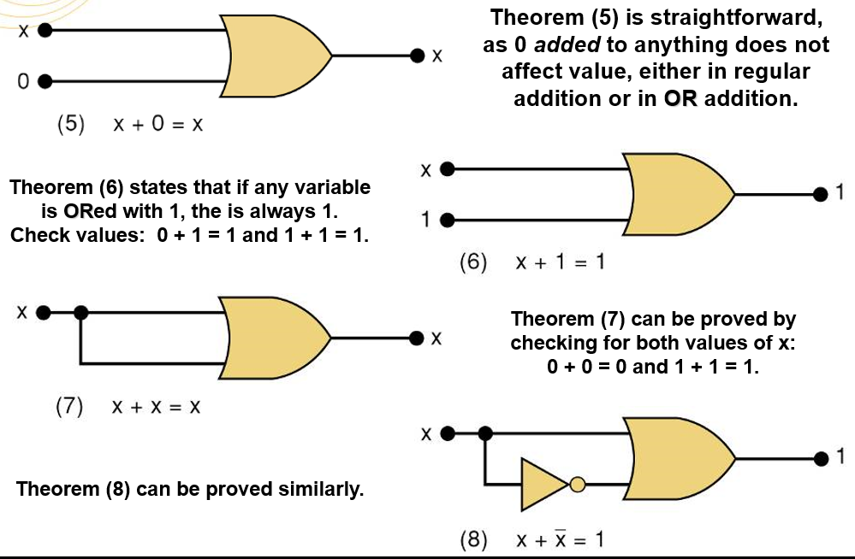
Free-form Lecture
Free-Form Lecture
In this lecture we attempted to verify 8 theorems using Multisim
The first 4 are for AND gates and the next 4 are for OR gates

Slide 12
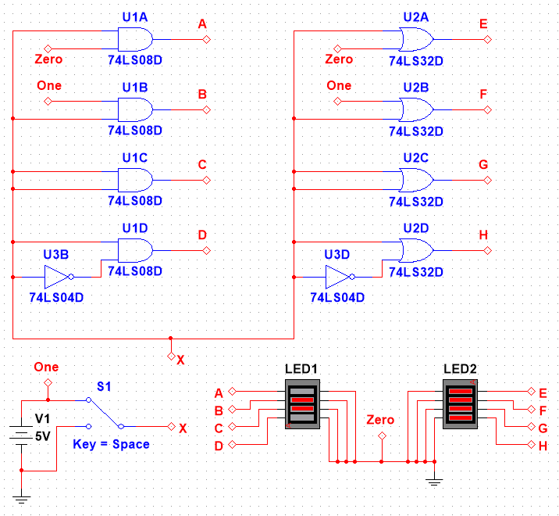
Free-form Lecture
Free-Form Lecture
I made several different simulations with various giving the reading, but I chose to display the simulation with the outputs running through two LED components with 4 lights each
Theorems 1-8
x | 1 | 2 | 3 | 4 | 5 | 6 | 7 | 8
0 | 0 | 0 | 0 | 0 | 0 | 1 | 0 | 1
1 | 0 | 1 | 1 | 0 | 1 | 1 | 1 | 1

Slide 13
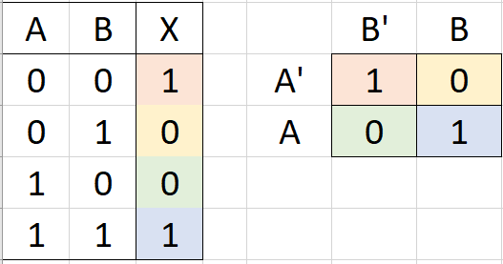
Lecture 4
Lecture 6 Slide 16
A Karnaugh map is a chart much like a atruth table, but with the inputs denoted with a bar (in this case an apostrophe) to indicate a logic zero

Slide 14
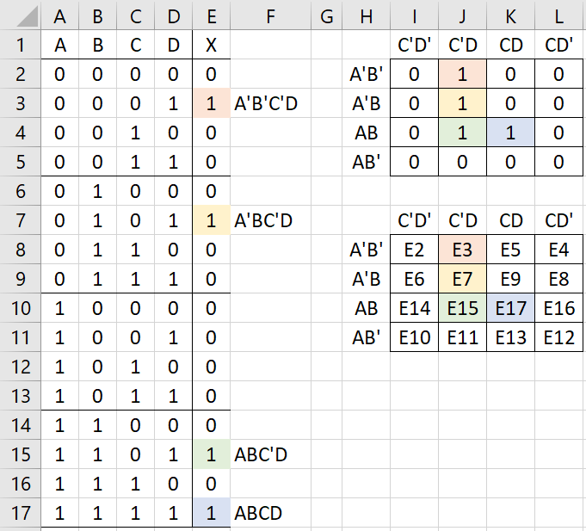
Lecture 4
Lecture 4 Slide 17
This Karnaugh map has 4 inputs so there are 16 possible outputs which are put in a grid like with the 2 input
In this case we were given the Boolean expression A’B’C’D+A’BC’D+ABC’D+ABCD
Using the Karnaugh map it can be reduced
A’C’D+ABD

Slide 15
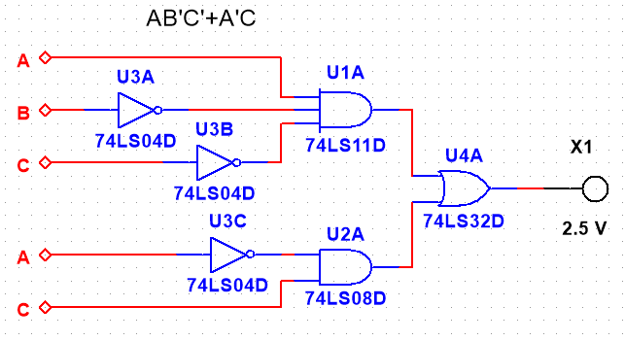
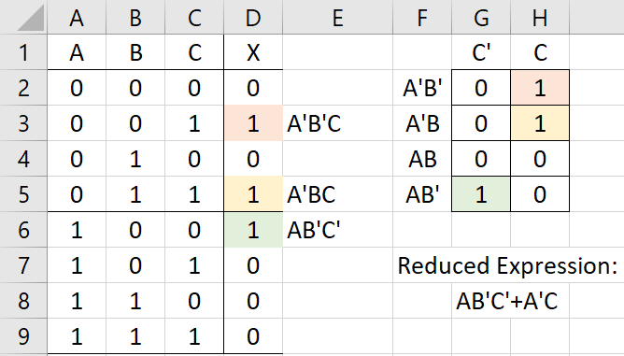
Lecture 4
Lecture 4 Slide 20
The next logical step was to use a reduced expression to make a circuit in Multisim
The Excel sheet shows the truth table and the Karnaugh map with the reduced expression from A’B’C+A’BC+AB’C’

